Slide 1
Temperature-Based Fashion Recommendation System
Sabina Azim and Natasha Vij
*Code to support the findings of this project can be found on Github*

Slide 2
Table of Contents
Introduction
Project Introduction and Background
Problem Statement
Literature Review
Relevant Research
Methodology
Data Description/Collection
Data Preprocessing
Data Modeling
Results and Analysis
Conclusion
Key Takeaways
Project Limitations and Future Research
References

Slide 3
Project Introduction

Slide 4
Project Introduction and Background
Inspiration:
Previous fashion recommendation work done by Kai Xin Thia
Senior Data Scientist at Refinitiv Labs
Gain more experience with image classification
Goal:
Compare the accuracy of Convolution Neural Network models for image classification
Create outfit recommendations system using model with highest accuracy
Display outfit recommendations on a visual platform

Slide 5
Problem Statement
Image classification models that are currently used in subscription based clothing companies can be enhanced. Improving current fashion companies' machine learning models and including new variables will provide a more personalized customer experience without human interaction, limiting the need to hire thousands of stylists.

Slide 6
Literature Review

Slide 7
Relevant Research
Source | Key Takeaways
Kai Xin Thia. Temporal Fashion Recommender. (2020). | Researcher considers how to factor in the seasonal outfit attributes into CNN model Accuracy rate was 66% in his research
Oloko-Oba, Mustapha, and Serestina Viriri. “Ensemble of EfficientNets for the Diagnosis of Tuberculosis.” Computational intelligence and neuroscience vol. 2021 9790894. 14 Dec. 2021, doi:10.1155/2021/9790894 | Two of most popular pre-trained models to train image classification on include ResNet and EfficientNet “The experimental results show the effectiveness of the EfficientNets in extracting and learning distinctive features...”

Slide 8
Methodology

Slide 9
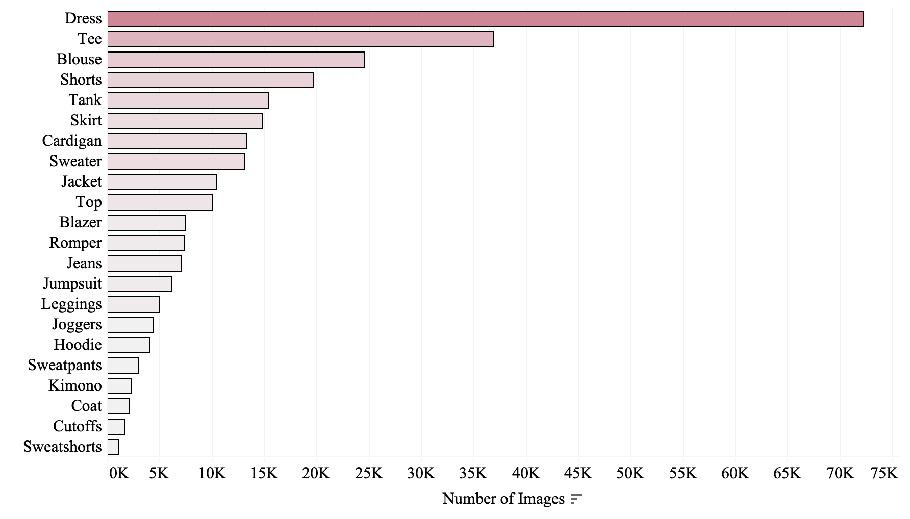
Data Description/Collection
Large-scale Fashion (DeepFashion) Database
280,000 diverse, colored fashion images
46 unique categories
1,000 descriptive attributes
*Only showing the categories w/ 1,000+ images

Slide 10
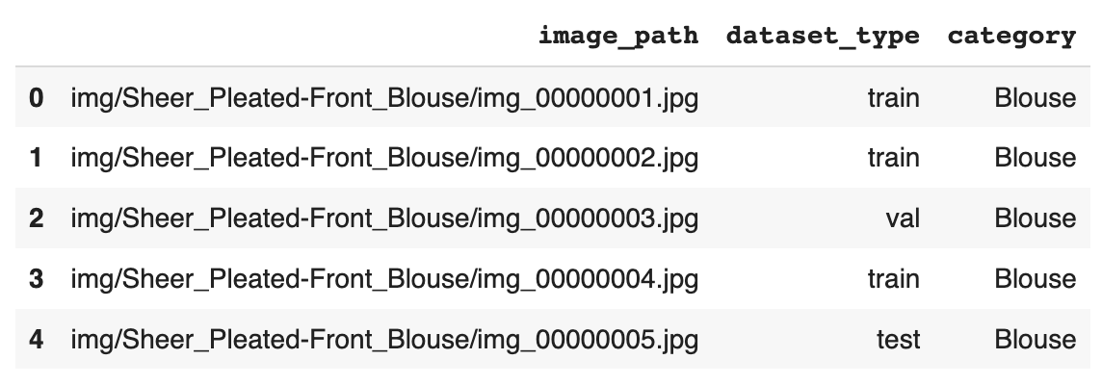
Data Preprocessing
Completed on Python - Google Collab Pro
The dataset downloaded already had the images split into 70% train, 15% validation, and 15% test.
Normalized data using ImageNet
Type | Count
Train | 209,222
Val | 40,000
Test | 40,000

Slide 11
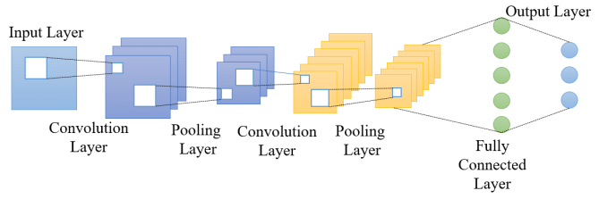
Data Modeling
Convolutional Neural Networks (CNN) models take an input image, assign weights to objects in an image, and then use those weights to differentiate from each other
CNN models can be trained using pre-trained models
ResNet-18 vs. ResNet-34 vs. ResNet-50
Trained on 18/34/50 layers
EfficientNet-B3 vs. EfficientNet-B5
Trained on 7 block and the modules inside the blocks are repeated 10/23 times
*Basic CNN Architecture

Slide 12
Results and Analysis

Slide 13
ResNet
ResNet has relieved the challenge of training very deep networks
Goal of ResNet is to add more layers
Layers progressively learn more complex features because of skip connections
ResNet | Train_Loss | Valid_loss | Accuracy | Runtime per Epoch
18 | 1.322088 | 1.229285 | 0.636225 | 28:13
34 | 1.228352 | 1.164590 | 0.655475 | 28:11
50 | 1.159371 | 1.092705 | 0.677525 | 34.42
Learning rate: 1e-02
Batch Size: 128
Epochs: 15

Slide 14
EfficientNet
Scaling method that uniformly scales all dimensions of depth/width/resolution
Helps achieve better performance
Fewer parameters than ResNet and generalizes well on new data
EfficientNet | Train_Loss | Valid_loss | Accuracy | Runtime per Epoch
B3 | 0.833898 | 0.993271 | 0.719800 | 40:08
B5 | 0.974802 | 0.991400 | 0.712425 | 1:50:39
Learning rate: 1e-03
Batch Size: 32/16
Epochs: 15

Slide 15
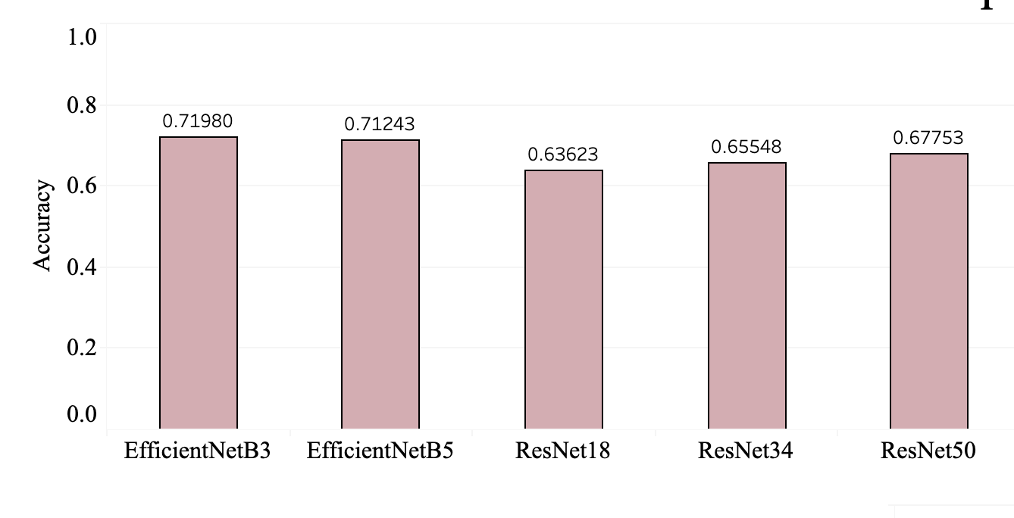
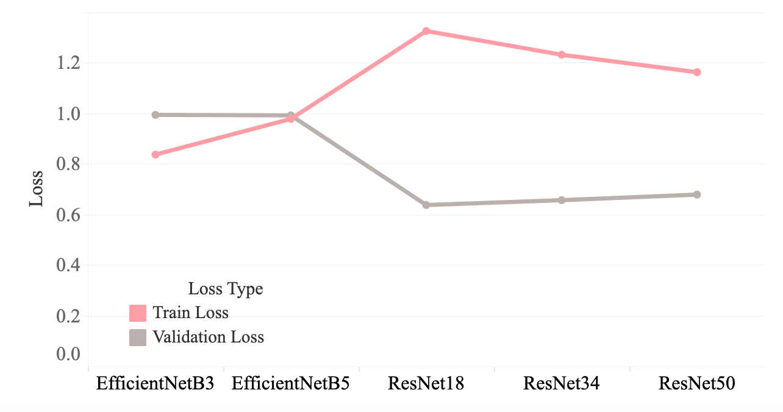
← Comparison of Model Accuracies
Comparison of Train and Val Loss →

Slide 16
Recommendation System
Use fast.ai to populate image embeddings
Manually group a few images together by weather/style
Use Annoy (Approximate Nearest Neighbors) to get similar images to the desired style/weather
Created by Spotify for their recommendation systems
Small memory usage
Main parameters → n_trees (larger values, better accuracy) and distance type (angular, euclidean, etc.)
We used n_trees = 100 and angular distance

Slide 17
Recommendation System Results
Temperature Blocks
‣ Freeze (32°F or less)
‣ Cold (33-50°F)
‣ Mild (51-70°F)
‣ Warm (71-90°F)
‣ Hot (91°F or more)
Styles
‣ Formal ‣ Athletic
‣ Classic ‣ Casual
‣ Grunge ‣ Preppy
‣ Bohemian
Weather/Style Grouping Examples: ‘Freeze-Casual’, ‘Warm-Grunge’
Results: AWS Hosted Website
Notes:
Link: http://temperature-fashion-recommendation-system.s3-website-us-east-1.amazonaws.com/

Slide 18
Conclusion

Slide 19
Key Takeaways
Convolutional Neural Networks are a fairly fast and accurate way to classify images
Fine-tuning of pretrained models can lead to higher accuracy
EfficientNet performed better at image classification than ResNet for our data
Annoy has the ability to perform nearest neighbors search with minimal memory usage

Slide 20
Project Limitations
Future Research
Some models were too deep (Ex. ResNet152) for us to train even with Collab Pro
We ran VGG16/19 as well but kept getting an extremely low accuracy rate even with a great deal of hyperparameter tuning
Time - models took hours to train
Increasing number of epochs for deeper learning
CNN-RNN Mixed Model for increased accuracy
Make an interactive GUI where users can enter desired style and weather

Slide 21
References

Slide 22
References
https://www.forbes.com/sites/tomdavenport/2021/03/12/the-future-of-work-now-ai-assisted-clothing-stylists-at-stitch-fix/?sh=4c2965843590
https://towardsdatascience.com/temporal-fashion-recommender-59c26313fa25
https://towardsdatascience.com/clothes-classification-with-the-deepfashion-dataset-and-fast-ai-1e174cbf0cdc
https://www.researchgate.net/publication/319569282_Weather-to-garment_Weather-oriented_clothing_recommendation
http://cs229.stanford.edu/proj2009/McDanielsWorsley.pdf
https://ieeexplore.ieee.org/document/9687944
https://towardsdatascience.com/a-comprehensive-hands-on-guide-to-transfer-learning-with-real-world-applications-in-deep-learning-212bf3b2f27a
https://www.mygreatlearning.com/blog/resnet/#sh1
https://www.analyticsvidhya.com/blog/2020/08/top-4-pre-trained-models-for-image-classification-with-python-code/?fbclid=IwAR37m9JLqu_42-kC2CIl5lqLMi0EgrnPQp4RwKPz6NO81p9uYC9tmJhFoqw

